Slide 1
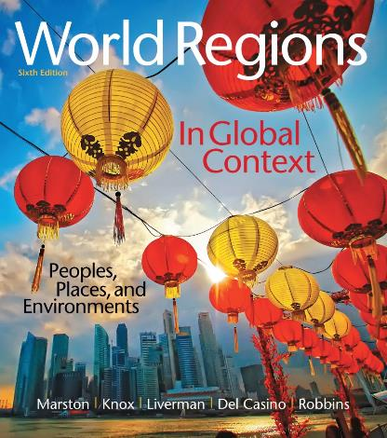
World Regions in Global Context:
Peoples, Places, and Environments
6th Edition
The United States
and Canada
Lectures by:
Christa Ann Smith

Slide 2
Learning Outcomes
Describe the distinctive landscapes of the United States and Canada with respect to landforms and climate.
Explain how the United States and Canada are affecting and affected by global climate change.
Understand the rise of the United States and Canada as key forces in the global economy.
Describe how the two countries’ dynamic economies contribute to and shape the global economy.
Summarize the economic inequality that exists in both the United States and Canada.

Slide 3
Learning Outcomes
Compare and contrast the forms and practice of government of the United States and Canada.
Summarize the indigenous and immigrant histories of the United States and Canada.
Describe the fundamentals of the geography of religion and language across the United States and Canada.
Compare and contrast the urbanization processes that have shaped the United States and Canada.

Slide 4
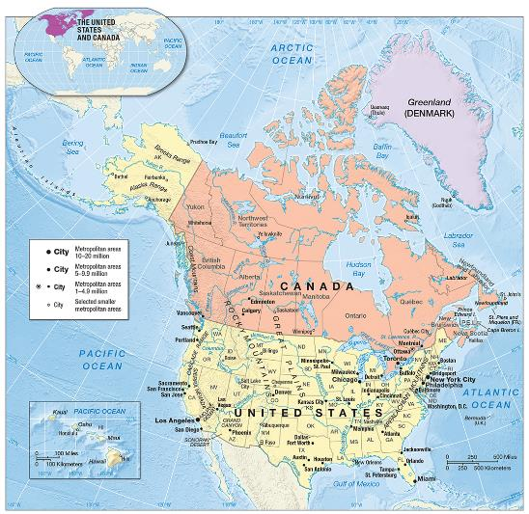
The United States and Canada
Highly developed region
Large landmass
Human adaptation to the environment

Slide 5
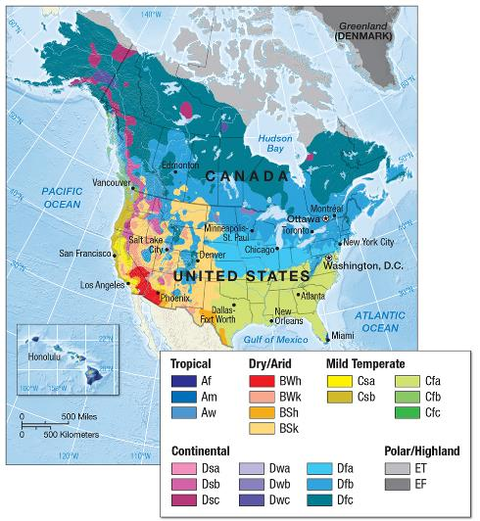
Climate, Adaptation, and Global Change
Nearly every climate pattern
  Arctic north
  Southeast United States
  Precipitation gradient
  Jet stream in winter months
  “Lake-effect” snow

Slide 6
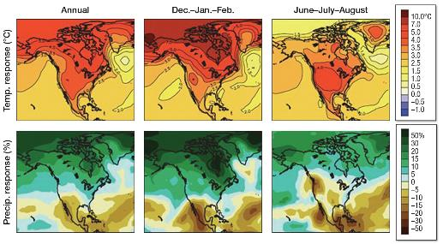
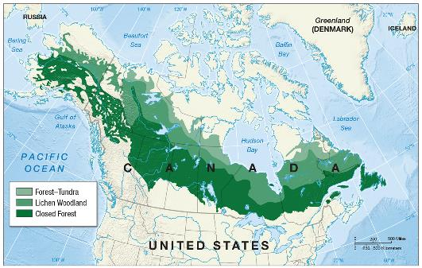
Climate, Adaptation, and Global Change (cont.)
Environmental modifications
  resource wealth
  technological capability for exploitation
Environmental impacts
  global climate change
  greenhouse gases
  large carbon footprint

Slide 7
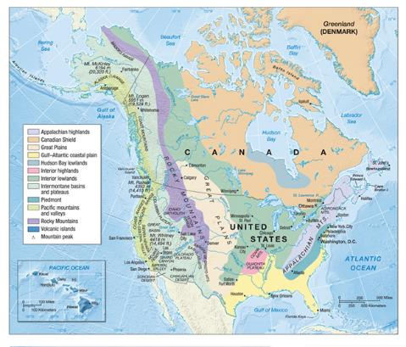
Geological Resources, Risk, and Water
Canadian Shield
Interior lowlands
Great Plains
Rocky Mountains
Appalachian Mountains
Atlantic Coastal Plain
River and lake systems

Slide 8
Geological Resources, Risk, and Water (cont.)
Energy and mineral resources
Countries top producers of natural gas
  substantial coal and oil reserves
  renewable sources

Slide 9
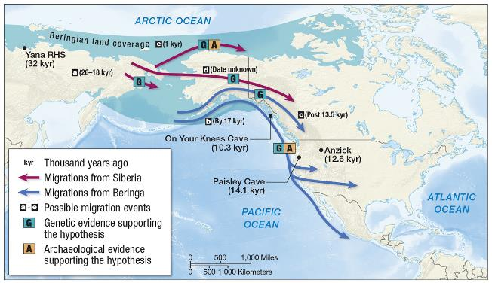
Ecology, Land, and Environmental Management
Indigenous land use
  land bridge
  subsistence production
  plant domestication

Slide 10
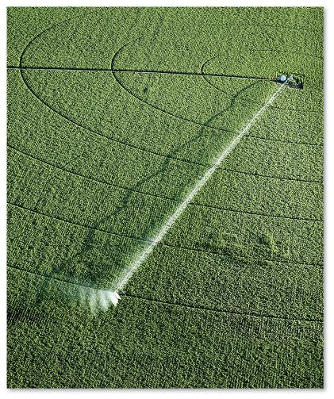
Ecology, Land, and Environmental Management (cont.)
Colonial land use
  resource commodification
  land ownership
  reservation/reserve
irrigation
acid rain
green goods and services
cap and trade programs

Slide 11
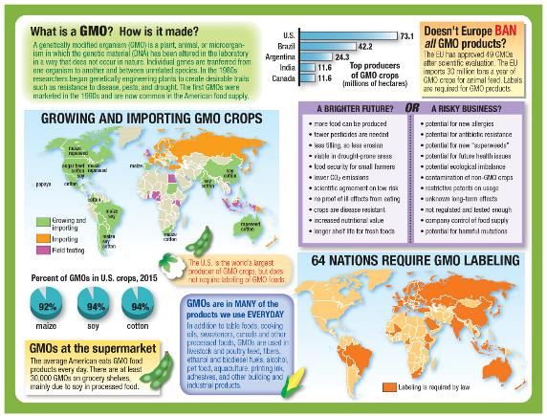
Ecology, Land, and Environmental Management (cont.)
Alternative food movements
  organic farming
  genetically modified organisms (GMOS)
  local food
  slow food

Slide 12
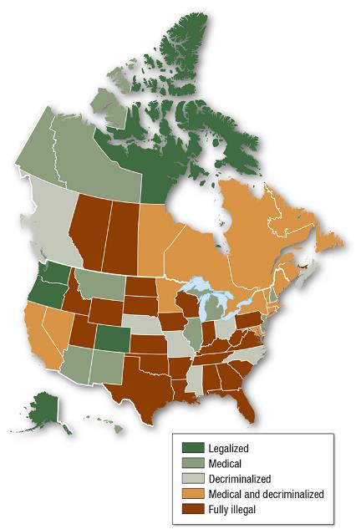
Geographies of Indulgence, Desire, and Addiction
Marijuana is the most commonly used illicit substance
Use is higher in developed countries
California and British Columbia
Legalization and interdiction

Slide 13
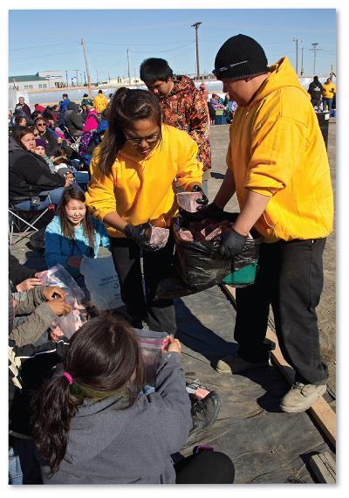
History, Economy, and Territory/Historical Landscapes
Indigenous histories
  wide range of cultural groups
  daily life governed by tribe and environment
  Europeans initially interested in commerce

Slide 14
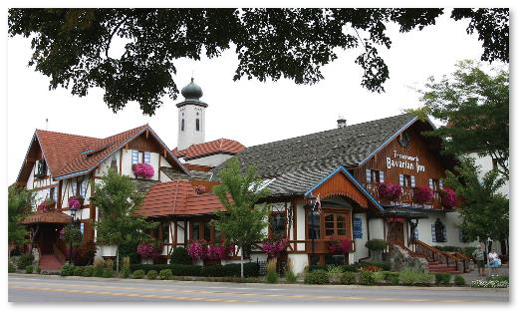
Historical Landscapes (cont.)
Colonization and independence
  Europeanization
    Great Britain dominant
  exploitation of native people
  French and Indian War
  American Revolution

Slide 15
Historical Landscapes (cont.)
Legacy of slavery
  different development for the U.S. North and South
  indentured servants
  reduction of native populations
  Atlantic slave trade

Slide 16
Historical Landscapes (cont.)
Settlement and industrialization
  continuous frontier settlement
  westward expansion in Canada
  industrialization of northeast United States
  U.S. Civil War
  North America Act of 1867

Slide 17
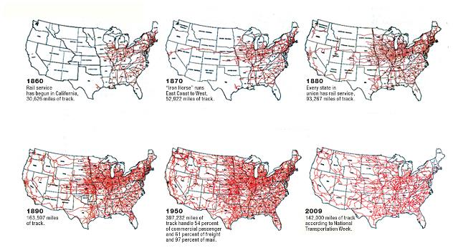
Economy, Accumulation, and the Production of Inequality
Two economies
  Canada
    staples economy
  United States
    far dominant

Slide 18
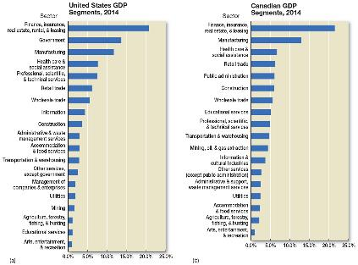
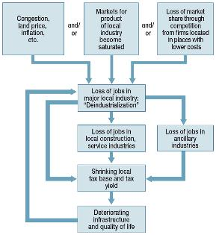
Economy, Accumulation, and the Production of Inequality (cont.)
Transforming economies
  Manufacturing Belt
  Rustbelt
    deindustrialization
  Sunbelt
  creative destruction
The new economy
  information technologies
  Canada’s role

Slide 19
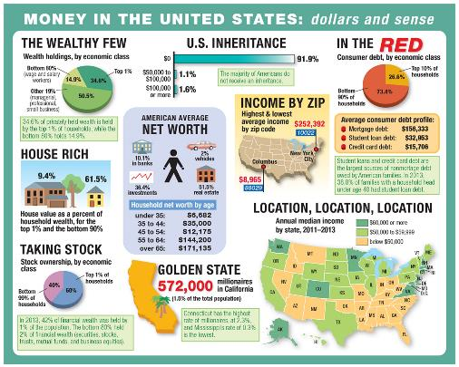
Economy, Accumulation, and the Production of Inequality (cont.)
Wealth inequality
Income inequality
Occupy Wall Street

Slide 20
Economy, Accumulation, and the Production of Inequality (cont.)
Global economic crisis
  bank failures in 2008
  personal and government debt
  mortgage crisis
  signs of recovery
  effects on Canada’s economy

Slide 21
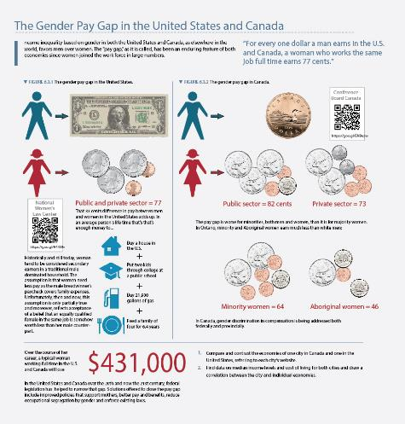
Visualizing Geography
The gender pay gap in the United States and Canada
  women earn 77 cents for every one dollar a man earns
  pay gap worse for minorities

Slide 22
Territory and Politics
Democracies
State and government
  federal system
  differences in the American and Canadian constitutions
  social welfare
  creation of Nunavut

Slide 23
Territory and Politics (cont.)
U.S. political and military influence
  Monroe Doctrine
  “America First”
  post-WWII
  end of the Cold War

Slide 24
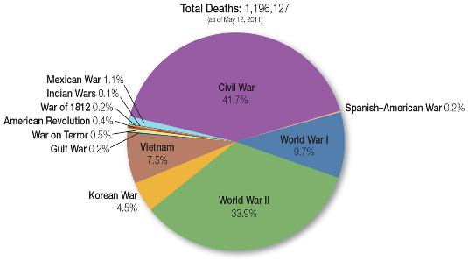

Territory and Politics (cont.)
U.S. War on Terror
  invasion of Afghanistan
  Iraq and Saddam Hussein
  Taliban and al-Qaeda
  high cost of the war

Slide 25
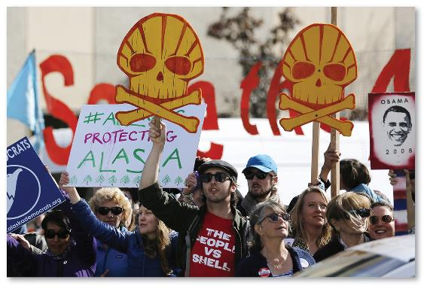
Territory and Politics (cont.)
Social movements
  women’s movement
    Seneca Falls, NY (1848)
  gays, disabled, children’s rights
  environmental movement

Slide 26
Culture and Populations/Religion and Language
United States
  predominantly English
  Roman Catholics and Protestants
  regional differences
    Bible Belt
  assimilation
Canada
  French and English
  multiculturalism

Slide 27

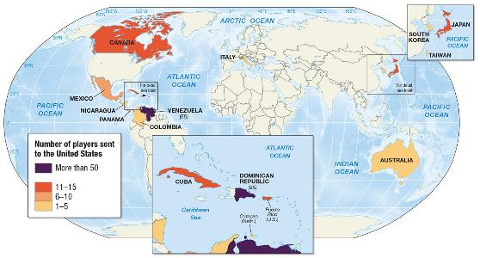
Cultural Practices, Social Differences, and Identity
Arts, music, and sports
  jazz
  Native American art
  baseball
U.S. cultural imperialism
  globalization or
  Americanization?

Slide 28

Cultural Practices, Social Differences, and Identity (cont.)
Cultural nationalism
  protection against American cultural invasion
  export of music and film personalities to
  the United States
Sex, gender, and sexuality
  Civil Marriage Act

Slide 29
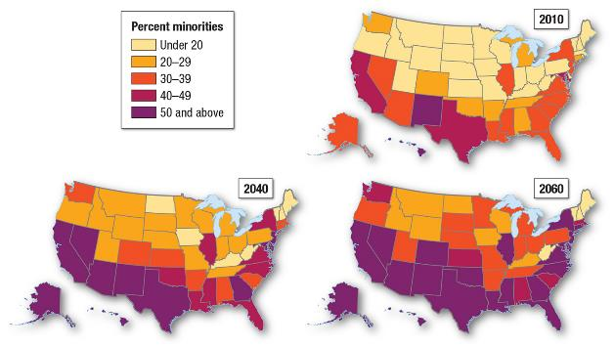
Demography and Urbanization
United States
  whites make up ¾ of total
  minorities have higher fertility
  Hispanics largest minority
Canada
  British and French
  descendants
  immigrant populations

Slide 30
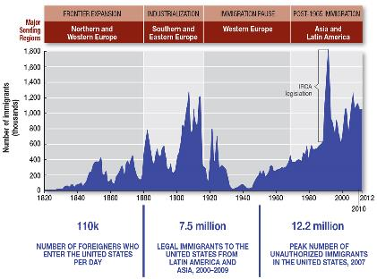
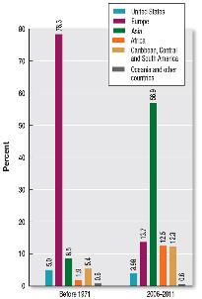
Demography and Urbanization (cont.)
Immigration
  United States
    first wave
    second wave
    third wave
  Canada
    French settlers
  resistance to immigrants
    hate crimes

Slide 31
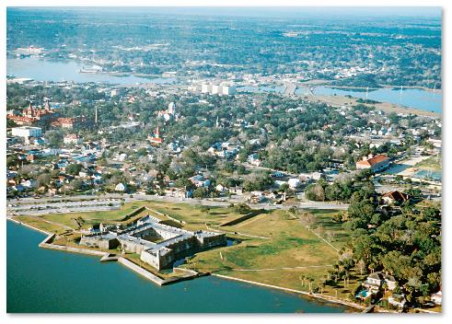
Demography and Urbanization (cont.)
Urbanization and industrialization
  indigenous cities
  European settlements
    commercial centers
  pull of manufacturing jobs
Suburbanization
  reasons for moving
  out of the city

Slide 32
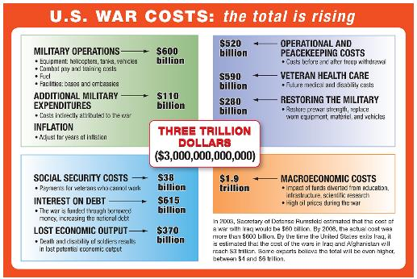
Future Geographies
U.S. dominance and challenge
  2008 recession
  China challenge
Security, terrorism,
and war
  ISIS
Environmental
change
  significant effects,
  but localized variations

